Slide 1
TurtleBot
Obstacle Avoidance

Slide 2
Purpose
The purpose of this program is to navigate the turtlebot to avoid the person passes by when going through the hallway.

Slide 3
Initialization
Place the turtlebot in one end of the hallway facing to another end and position it to be in the center.
Run the command line in the following slide.
After the program is up and running, the test subject can walk into the turtlebot, the turtlebot will avoid the test subject.

Slide 4
Initialization
In command terminal
“roscd” to catkin workspace
“catkin_make”
“roslaunch turtlebot_bringup minimal.launch”
in a new window
“roslaunch turtlebot_bringup 3dsensor.launch”
4. in a new window
“rosrun safe_turtle safe_turtlebot”
5. in a new window
“rosrun crossing obstacle1”

Slide 5
Obstacle Avoidance Range
The figure on the right depicts the working range of this program. The test subject should walk within the area the red lines enclosed. This program does not work properly if the test subject is too close to the sensor or too close to the walls.
5 cm
10 cm
10 cm
20 cm
125 cm
120 cm
90 cm
60 cm
180 cm

Slide 6
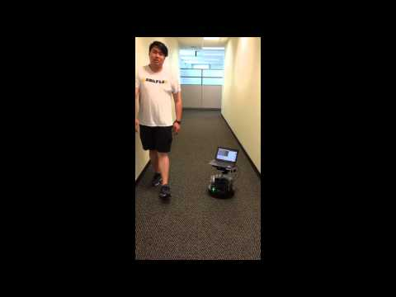
Demo

Slide 7
Program
The program is available at https://github.gatech.edu/wliu88/turtlebot.git
(clone repo with gt account and password)
The demo video is available at
https://www.youtube.com/watch?v=VqYyENpbYWw

